Slide 1
Array And Strings
Course Title :- Structured Programming Language Sessional
Course Code :- CSE-122 [SECTION-B]
Level Term: 1-II-A(G1) & 1-II-B(G3,G4)
Khandaker Jannatul Ritu, Lecturer(CSE), BAIUST

Slide 2
Outlines:-
Bangla resources:
https://jakir.me/c-array/ (best)
http://cpbook.subeen.com/2011/08/array-programming-c.html
https://bncodeing.com/what-is-array-in-c/ (better)

Slide 3
Outlines
PART - 1 : 1D array taking input and print output
integer array
float array
double array
PART - 2 : 2D array taking input and print output
integer array
float array
double array
PART - 3 : 3D array taking input and print output
integer array
float array
double array
PART - 4 : Properties of array – show using 1d, 2d
PART - 5 : Some c-programs integer array – anisul
PART - 6 : 1D array taking input and print output
character array
PART - 7 : String functions – anisul
PART - 8 : String programs – anisul
PART - 6 : 2D array taking input and print output
character array

Slide 4
Types of Array in C
There are two types of arrays based on the number of dimensions it has. They are as follows:
One Dimensional Arrays (1D Array)
Multidimensional Arrays
1. One Dimensional Array in C
The One-dimensional arrays, also known as 1-D arrays in C are those arrays that have only one dimension.
Syntax of 1D Array in C
array_name [size];
2. Multidimensional Array in C
A. Two-Dimensional Array in C
A Two-Dimensional array or 2D array in C is an array that has exactly two dimensions. They can be visualized in the form of rows and columns organized in a two-dimensional plane.
Syntax of 2D Array in C
array_name[size1] [size2];
B. Three-Dimensional Array in C
Another popular form of a multi-dimensional array is Three Dimensional Array or 3D Array. A 3D array has exactly three dimensions. It can be visualized as a collection of 2D arrays stacked on top of each other to create the third dimension.
Syntax of 3D Array in C
array_name [size1] [size2] [size3];

Slide 5
PART - 1 : 1D array taking input and print output
integer array
Integer Array declaration
Integer Array initialization
Integer Array access
Integer Array update
Integer Array traversal
Integer Array Copy to another array
float array
Float Array declaration
Float Array initialization
Float Array access
Float Array update
Float Array traversal
Float Array Copy to another array
double array
Double Array declaration
Double Array initialization
Double Array access
Double Array update
Double Array traversal
Double Array Copy to another array

Slide 6
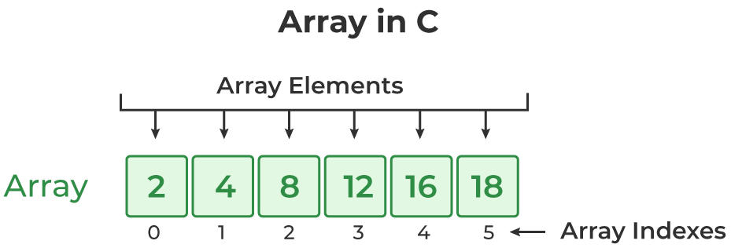
1D array taking input and print output - Integer
Array in C What is Array in C?
An array in C is a fixed-size collection of similar data items stored in contiguous memory locations.
It can be used to store the collection of primitive data types such as int, char, float, etc.
It is a simple and fast way of storing multiple values under a single name.

Slide 7
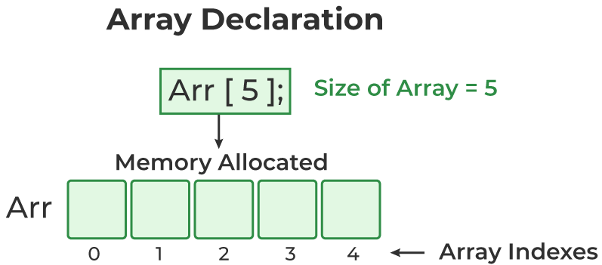
1. C Array Declaration
data_type array_name [size]; or data_type array_name [size1] [size2]...[sizeN];
// declaring array of integers
int age[5];
// declaring array of characters
double prices[5];
// declaring array of characters
float height[5];
// declaring array of characters
char alphabets[5];

Slide 8
Array declaration
int age[10];
0 - based indexing
Index | 0 | 1 | 2 | 3 | 4 | 5 | 6 | 7 | 8 | 9
Values
1 - based indexing
Index | 1 | 2 | 3 | 4 | 5 | 6 | 7 | 8 | 9 | 10
Values

Slide 9
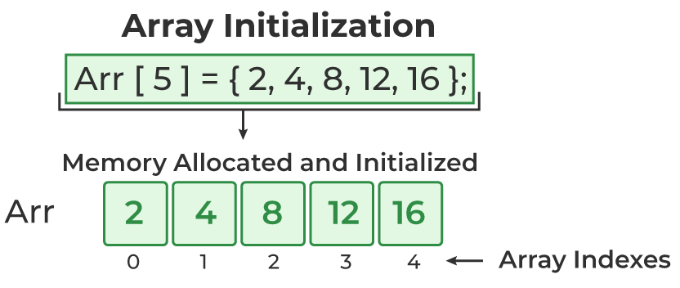
2. Array initialization [ How to put values in array? ]
1. 0 – base indexing
int main()
{
int age[5];
age[0] = 20;
age[1] = 21;
age[2] = 20;
age[3] = 34;
age[4] = 12;
}
2. 1 – base indexing
int main()
{
int age[5];
age[1] = 21;
age[2] = 20;
age[3] = 34;
age[4] = 12;
age[5] = 20;
}
3. Array Initialization with Declaration
int age[5] = {20, 21, 22, 23, 12};
5. Array Initialization using user input
int n;
scanf("%d", &n);
int array[n];
for(int i = 0; i <n; i++)
{
scanf(“%d ”, &array[i] );
}
4. Array Initialization with Declaration without Size
int age[ ] = {11, 21, 32, 43, 56};

Slide 10
3. Array access [ How to print array? ]
// 0 – base indexing
int main()
{
int age[5];
age[0] = 20;
age[1] = 21;
age[2] = 20;
age[3] = 34;
age[4] = 12;
printf(“%d ”, age[4]);
printf(“%d ”, age[1]);
printf(“%d ”, age[3]);
printf(“%d %d”, age[0], age[2]);
}
int main()
{ int age[5] = {20, 21, 22, 23, 12};
printf(“%d ”, age[4]);
printf(“%d ”, age[1]);
printf(“%d ”, age[3]);
printf(“%d %d”, age[0], age[2]);
}
int main()
{ int age[ ] = {20, 21, 22, 23, 12};
printf(“%d ”, age[4]);
printf(“%d ”, age[1]);
printf(“%d ”, age[3]);
printf(“%d %d”, age[0], age[2]);
}

Slide 11
Array access [ How to print array? ]
// C Program to illustrate element access
#include <stdio.h>
int main()
{
int arr[5] = { 15, 25, 35, 45, 55 };
printf("Element at arr[2]: %d\n", arr[2]);
printf("Element at arr[4]: %d\n", arr[4]);
printf("Element at arr[0]: %d", arr[0]);
}
Element at arr[2]: 35
Element at arr[4]: 55
Element at arr[0]: 15
int n;
scanf("%d", &n);
int array[n];
for(int i = 0; i <n; i++)
{
scanf(“%d ”, &array[i] );
}
for(int i=0; i<n; i++)
{
printf(“%d ”, array[i]);
}

Slide 12
4. Update Array Element
main(){
int arr[5] = { 15, 25, 35, 45, 55 };
arr[2] = -1;
printf(“%d ”, age[0]);
printf(“%d ”, age[1]);
printf(“%d ”, age[2]);
printf(“%d ”, age[3]);
printf(“%d ”, age[4]);
printf(“%d ”, age[5]);
}
int n;
scanf("%d", &n);
int array[n];
for(int i = 0; i <n; i++)
{
scanf(“%d ”, &array[i] );
}
array[0] = - 555;
for(int i=0; i<n; i++)
{
printf(“%d ”, array[i]);
}

Slide 13
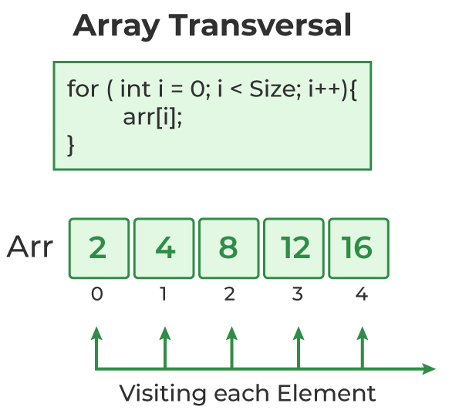
5. C Array Traversal
Traversal is the process in which we visit every element of the data structure. For C array traversal, we use loops to iterate through each element of the array.
Array Traversal using for Loop
int n;
scanf("%d", &n);
int array[n];
for(int i = 0; i <n; i++){
scanf(“%d ”, &array[i] );
}
for(int i=0; i<n; i++){
printf(“%d ”, array[i]);
}

Slide 14
6. Copy Array To Another Array
int main(){
int N=5;
int array1[N];
int array2[N];
for(int i=1; i<= N; i++){
scanf("%d", &array1[i]);
}
printf("\n array-1 \n");
for(int i=1; i<= N; i++){
printf("%d ", array1[i]);
}
printf("\n\n");
for(int i=1; i<= N; i++){
array2[i] = array1[i];
}
printf("\n array-1 \n");
for(int i=1; i<= N; i++){
printf("%d ", array2[i]);
}
printf("\n\n");
}
Traversal is the process in which we visit every element of the data structure. For C array traversal, we use loops to iterate through each element of the array.

Slide 15
1D array taking input and print output - Float
Array declaration
Array initialization
Array access
Array update
Array traversal
Float – Type Array
Array Traversal using for Loop
int n;
scanf("%d", &n);
float array[n];
for(int i = 0; i <n; i++){
scanf(“%f ”, &array[i] );
}
array[0] = 100.11;
for(int i=0; i<n; i++){
printf(“%f ”, array[i]);
}

Slide 16
1D array taking input and print output – Double
Array declaration
Array initialization
Array access
Array update
Array traversal
Double – Type Array
Array Traversal using for Loop
int n;
scanf("%d", &n);
double array[n];
for(int i = 0; i <n; i++){
scanf(“%lf ”, &array[i] );
}
array[n] = -5.43;
for(int i=0; i<n; i++){
printf(“%lf ”, array[i]);
}

Slide 17
PART - 2 : 2D array taking input and print output
integer array
Integer Array declaration
Integer Array initialization
Integer Array access
Integer Array update
Integer Array traversal
Integer Array Copy to another array
float array
Float Array declaration
Float Array initialization
Float Array access
Float Array update
Float Array traversal
Float Array Copy to another array
double array
Double Array declaration
Double Array initialization
Double Array access
Double Array update
Double Array traversal
Double Array Copy to another array

Slide 18
2D array taking input and print output – Integer
2-Dimensional Array in C
A Two-Dimensional array or 2D array in C is an array that has exactly two dimensions. They can be visualized in the form of rows and columns organized in a two-dimensional plane.
[1] Array declaration
//method-1
row = 3;
col = 4;
int matrix[row][col] ;
//method-2
int array[2][3];
//method-3
int n,m;
scanf(“%d %d”, &n, &m);
int matrix[ n ][ m ];
0-based indexing 2D array
i / j | j=0 | j=1 | j=2 | j=3
i=0 | 10 [0, 0] | 20 [0, 1] | 30 [0, 2] | 40 [0, 3]
i=1 | 10 [1, 0] | 20 [1, 1] | 30 [1, 2] | 40 [1, 3]
i=2 | 10 [2, 0] | 20 [2, 1] | 30 [2, 2] | 40 [2, 3]
i=3 | 10 [3, 0] | 20 [3, 1] | 30 [3, 2] | 40 [3, 3]

Slide 19
1-based indexing 2D array
i / j | j=1 | j=2 | j=3 | j=4
i=1 | 10 [1, 1] | 20 [1, 2] | 30 [1, 3] | 40 [1, 4]
i=2 | 10 [2, 1] | 20 [2, 2] | 30 [2, 3] | 40 [2, 4]
i=3 | 10 [3, 1] | 20 [3, 2] | 30 [3, 3] | 40 [3, 4]
i=4 | 10 [4, 1] | 20 [4, 2] | 30 [4, 3] | 40 [4, 4]

Slide 20
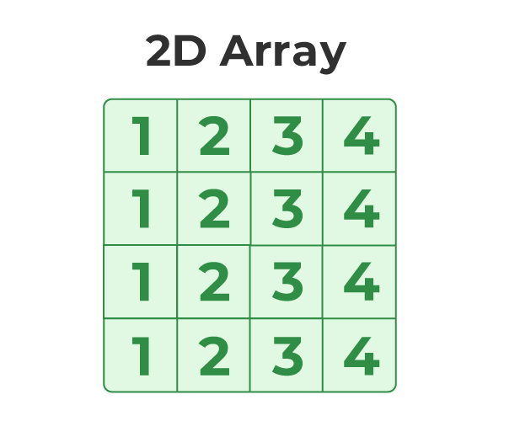
[2] Array Initialization
//method-1
int row=3;
int col=4;
int matrix[row][col] = {{5, 5,5,5}, {1,2,3,4}, {4,3,2,1} }
//method-2
int col=4;
int matrix[ ][col] = {{5, 5,5,5}, {1,2,3,4}, {4,3,2,1} }
//method-3: 0-based indexing
int row, col;
scanf(“%d %d”, &row, &col);
int matrix[ row ] [ col ] ;
for(i = 0; i<row; i++)
{
for(j=0; j<col; j++)
{
scanf(“%d ”, &matrix[ i ][ j] );
}
}
//method-4
int mx[3][4] = {0, 1 ,2 ,3 ,4 , 5 , 6 , 7 , 8 , 9 , 10 , 11}
//method-3: 1-based indexing
int row, col;
scanf(“%d %d”, &row, &col);
int matrix[ row ] [ col ] ;
for(i = 1; i<=row; i++)
{
for(j=1; j<=col; j++)
{
scanf(“%d ”, &matrix[ i ][ j] );
}
}

Slide 21
[3] Array Access [ How to print a 2D array? ]
//method-1
int row=3;
int col=4;
int matrix[row][col] = {{5, 5,5,5}, {1,2,3,4}, {4,3,2,1} }
printf(“%d ”, matrix[ 0 ][ 0 ] );
printf(“%d ”, matrix[ 0 ][ 1 ] );
printf(“%d ”, matrix[ 0 ][ 2 ] );
printf(“%d ”, matrix[ 0 ][ 3 ] );
printf(“%d ”, matrix[ 1 ][ 0 ] );
printf(“%d ”, matrix[ 1 ][ 1 ] );
printf(“%d ”, matrix[ 1 ][ 2 ] );
printf(“%d ”, matrix[ 1 ][ 3 ] );
printf(“%d ”, matrix[ 2][ 0 ] );
printf(“%d ”, matrix[ 2 ][ 1 ] );
printf(“%d ”, matrix[ 2 ][ 2 ] );
printf(“%d ”, matrix[ 2 ][ 3 ] );
//method-2
int row, col;
scanf(“%d %d”, &row, &col);
int matrix[ row ] [ col ] ;
for(i = 0; i<row; i++)
{
for(j=0; j<col; j++){
scanf(“%d ”, &matrix[ i ][ j] );
}
}
for(i = 0; i<row; i++)
{
for(j=0; j<col; j++){
printf(“%d ”, matrix[ i ][ j] );
}
}

Slide 22
[4] Array Update
//method-2
int row, col;
scanf(“%d %d”, &row, &col);
int matrix[ row ] [ col ] ;
for(i = 0; i<row; i++){
for(j=0; j<col; j++){
scanf(“%d ”, &matrix[ i ][ j] );
}
}
matrix[ 0 ][ 0 ] = -30;
for(i = 0; i<row; i++){
for(j=0; j<col; j++){
printf(“%d ”, matrix[ i ][ j] );
}
}
//method-1
int row=3;
int col=4;
int matrix[row][col] = {{5, 5,5,5}, {1,2,3,4}, {4,3,2,1} }
printf(“%d ”, matrix[ 0 ][ 0 ] );
printf(“%d ”, matrix[ 0 ][ 1 ] );
printf(“%d ”, matrix[ 0 ][ 2 ] );
printf(“%d ”, matrix[ 0 ][ 3 ] );
matrix[ 0 ][ 0 ] = -1;
matrix[ 0 ][ 1 ] = -1;
matrix[ 0 ][ 2 ] = -1;
matrix[ 0 ][ 3 ] = -1;
printf(“%d ”, matrix[ 0 ][ 0 ] );
printf(“%d ”, matrix[ 0 ][ 1 ] );
printf(“%d ”, matrix[ 0 ][ 2 ] );
printf(“%d ”, matrix[ 0 ][ 3 ] );

Slide 23
[5] Array Traversal
//method-1: 0-based indexing
int row, col;
scanf(“%d %d”, &row, &col);
int matrix[ row ] [ col ] ;
for(i = 0; i<row; i++){
for(j=0; j<col; j++){
scanf(“%d ”, &matrix[ i ][ j] );
}
}
for(i = 0; i<row; i++){
for(j=0; j<col; j++){
printf(“%d ”, matrix[ i ][ j] );
}
}
//method-2: 1-based indexing
int row, col;
scanf(“%d %d”, &row, &col);
int matrix[ row ] [ col ] ;
for(i = 1; i<=row; i++){
for(j=1; j<=col; j++){
scanf(“%d ”, &matrix[ i ][ j] );
}
}
for(i = 1; i<=row; i++){
for(j=1; j<=col; j++){
printf(“%d ”, matrix[ i ][ j] );
}
}

Slide 24
[6] Copy Array To Another
int row, col;
scanf(“%d %d”, &row, &col);
int matrix[ row ] [ col ] ;
int patrix[ row ] [ col ] ;
for(int i=1; i<=row; i++){
for(int j=1; j<=col; j++){
scanf("%d", &matrix[i][j]);
}
}
for(int i=1; i<=row; i++){
for(int j=1; j<=col; j++){
printf("%d ", matrix[i][j]);
}
printf("\n");
}
for(int i=1; i<=row; i++){
for(int j=1; j<=col; j++){
patrix[i][j] = matrix[i][j];
}
printf("\n");
}
printf("\n copy to another matrix\n");
for(int i=1; i<=row; i++){
for(int j=1; j<=col; j++){
printf("%d ", patrix[i][j]);
}
printf("\n");
}

Slide 25
2D array taking input and print output - Float
//method-1: 0-based indexing
int row, col;
scanf(“%d %d”, &row, &col);
float matrix[ row ] [ col ] ;
for(i = 0; i<row; i++){
for(j=0; j<col; j++){
scanf(“%f ”, &matrix[ i ][ j] );
}
}
matrix[ 0 ][ 0 ] = -1.555;
for(i = 0; i<row; i++){
for(j=0; j<col; j++){
printf(“%f ”, matrix[ i ][ j] );
}
}
//method-2: 1-based indexing
int row, col;
scanf(“%d %d”, &row, &col);
float matrix[ row ] [ col ] ;
for(i = 1; i<=row; i++){
for(j=1; j<=col; j++){
scanf(“%f ”, &matrix[ i ][ j] );
}
}
matrix[ 1 ][ 1 ] = -1.555;
for(i = 1; i<=row; i++){
for(j=1; j<=col; j++){
printf(“%f ”, matrix[ i ][ j] );
}
}

Slide 26
2D array taking input and print output - Double
//method-1: 0-based indexing
int row, col;
scanf(“%d %d”, &row, &col);
double matrix[ row ] [ col ] ;
for(i = 0; i<row; i++){
for(j=0; j<col; j++){
scanf(“%lf ”, &matrix[ i ][ j] );
}
}
matrix[ 0 ][ 0 ] = -1.555;
for(i = 0; i<row; i++){
for(j=0; j<col; j++){
printf(“%lf ”, matrix[ i ][ j] );
}
}
//method-2: 1-based indexing
int row, col;
scanf(“%d %d”, &row, &col);
double matrix[ row ] [ col ] ;
for(i = 1; i<=row; i++){
for(j=1; j<=col; j++){
scanf(“%lf ”, &matrix[ i ][ j] );
}
}
matrix[ 1 ][ 1 ] = -1.555;
for(i = 1; i<=row; i++){
for(j=1; j<=col; j++){
printf(“%lf ”, matrix[ i ][ j] );
}
}

Slide 27
PART - 3 : 3D array taking input and print output
integer array
Integer Array declaration
Integer Array initialization
Integer Array access
Integer Array update
Integer Array traversal
Integer Array Copy to another array
float array
Float Array declaration
Float Array initialization
Float Array access
Float Array update
Float Array traversal
Float Array Copy to another array
double array
Double Array declaration
Double Array initialization
Double Array access
Double Array update
Double Array traversal
Double Array Copy to another array

Slide 28
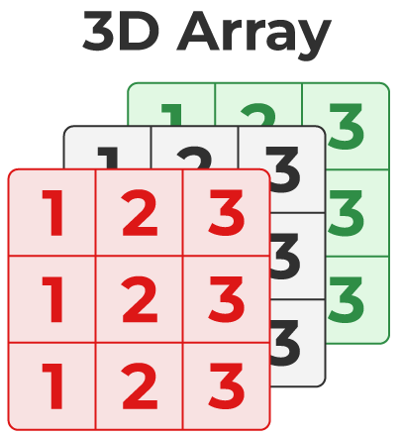
3-Dimensional Array in C
Another popular form of a multi-dimensional array is Three Dimensional Array or 3D Array. A 3D array has exactly three dimensions. It can be visualized as a collection of 2D arrays stacked on top of each other to create the third dimension.
Syntax of 3D Array in C
array_name [size1] [size2] [size3];
// C Program to illustrate the 3d array
#include <stdio.h>
int main()
{
int arr[2][2][2] = { 10, 20, 30, 40, 50, 60 };
for (int i = 0; i < 2; i++) {
for (int j = 0; j < 2; j++) {
for (int k = 0; k < 2; k++) {
printf("%d ", arr[i][j][k]);
}
printf("\n");
}
printf("\n \n");
}
}
10 20
30 40
50 60
0 0

Slide 29
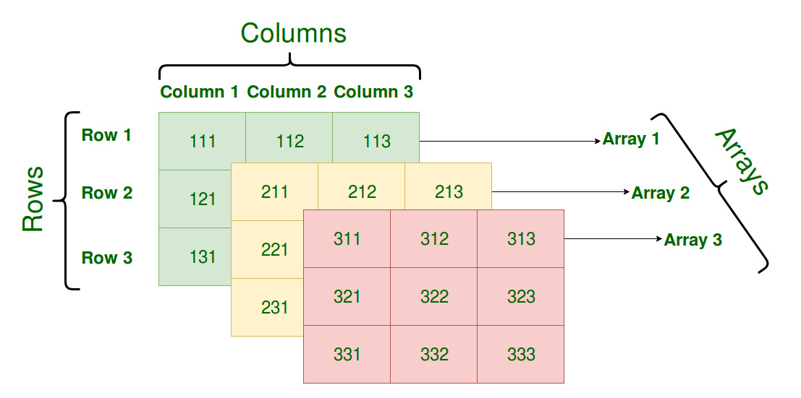
Three-Dimensional Array in C
A Three Dimensional Array or 3D array in C is a collection of two-dimensional arrays. It can be visualized as multiple 2D arrays stacked on top of each other.

Slide 30
PART - 4: C Array Properties
1. Fixed Size of an Array
In C, the size of an array is fixed after its declaration. It should be known at the compile time and it cannot be modified later in the program. The below example demonstrates the fixed-size property of the array.
// C Program to Illustrate the Fixed Size Properties of the Array
#include <stdio.h>
int main(){
int array[5] = { 1, 2, 3, 4, 5 };
printf("Size of Array Before: %d\n",sizeof(array) / sizeof(int));
array[6];
printf("Size of Array After: %d", sizeof(array) / sizeof(int));
}
Output
Size of Array Before: 5
Size of Array After: 5

Slide 31
2. Homogeneous Collection
An array in C cannot have elements of different data types. All the elements are of the same type.
// C program to Demonstrate the Homogeneous Property of the C Array
#include <stdio.h>
int main(){
int arr[3] = { 1, 2 };
arr[2] = "Geeks";
printf("Array[1]: %d\n", arr[0]);
printf("Array[2]: %d\n", arr[1]);
printf("Array[3]: %s", arr[2]);
}
Output
Array[1]: 1
Array[2]: 2

Slide 32
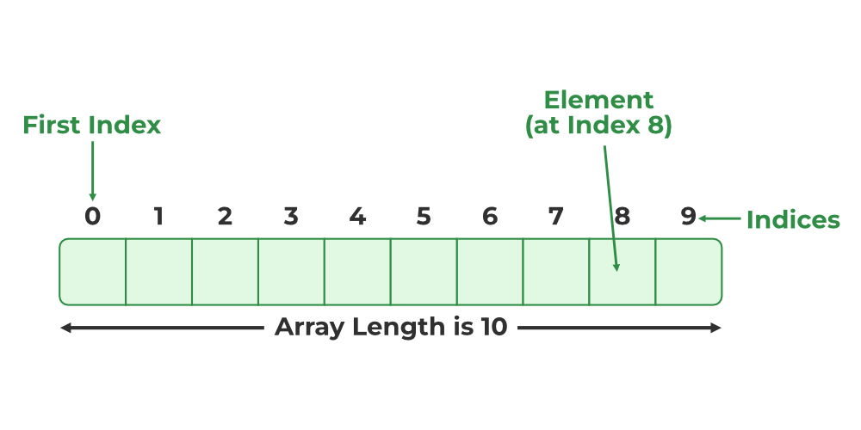
3. Indexing in an Array
Indexing of elements in an Array in C starts with 0 instead of 1. It means that the index of the first element will be 0 and the last element will be (size – 1) where size is the size of the array.
// C Program to Illustrate Array Indexing in C
#include <stdio.h>
int main(){
int arr[2] = { 10, 20 };
printf("Array[1]: %d\n", arr[1]);
printf("Array[0]: %d", arr[0]);
}
Output
Array[1]: 20
Array[0]: 10

Slide 33
4. Dimensions of the Array
It can have any number of dimensions. The number of elements in a multidimensional array is the product of the size of all the dimensions.
// C Program to create multidimensional array
#include <stdio.h>
int main(){
int arr2d[2][2] = { 1, 2, 3, 4 };
int arr3d[2][2][2] = { 1, 2, 3, 4, 5, 6, 7, 8 };
printf("2D Array: ");
for (int i = 0; i < 2; i++) {
for (int j = 0; j < 2; j++) {
printf("%d ", arr2d[i][j]);
}
}
printf("\n3D Array: ");
for (int i = 0; i < 2; i++) {
for (int j = 0; j < 2; j++) {
for (int k = 0; k < 2; k++) {
printf("%d ", arr3d[i][j][k]);
}
}
}
}
Output
2D Array: 1 2 3 4
3D Array: 1 2 3 4 5 6 7 8

Slide 34
5. Random Access
The array in C provides random access to its element i.e we can get to a random element at any index of the array in constant time complexity just by using its index number.
6. No Index Out of Bounds Checking
There is no index out-of-bounds checking in C/C++, for example, the following program compiles fine but may produce unexpected output when run.
// This C program compiles fine as index out of bound is not checked in C.
#include <stdio.h>
int main(){
int arr[2];
printf("%d ", arr[3]);
printf("%d ", arr[-2]);
}
Output:
211343841 4195777
In C, it is not a compiler error to initialize an array with more elements than the specified size. For example, the below program compiles fine and shows just a Warning.
#include <stdio.h>
int main(){
// Array declaration by initializing it
// with more elements than specified size.
int arr[2] = { 10, 20, 30, 40, 50 };
}

Slide 35
7. Bound Checking
Bound checking is the process in which it is checked whether the referenced element is present within the declared range of the Array. In C language, array bound checking is not performed so we can refer to the elements outside the declared range of the array leading to unexpected errors.
// C Program to Illustrate the Out of Bound access in arrays
#include <stdio.h>
int main(){
int arr[3] = { 1, 2, 3 };
printf("Some Garbage Value: %d", arr[5]);
}
Output
Some Garbage Value: 0

Slide 36
1D array
Copy array to another
C programming Bangla Tutorial 5.167 : Array | Sum and Average of an Array
C programming Bangla Tutorial 5.170 : Array | Searching a number (Linear search)
C programming Bangla Tutorial 5.168 : Array | Maximum and Minimum of Array
2D array
Copy array to another
C programming Bangla Tutorial 5.175 : Array | Matrix Addition & Subtraction
C programming Bangla Tutorial 5.179 : Array | Sum of diagonal elements of a matrix

Slide 37
Copy array to another
2. Sum and Average of an Array
#include<stdio.h>
int main(){
int N=5;
int array1[N];
int array2[N];
for(int i=1; i<= N; i++){
scanf("%d", &array1[i]);
}
printf("\n array-1 \n");
for(int i=1; i<= N; i++){
printf("%d ", array1[i]);
}
printf("\n\n");
for(int i=1; i<= N; i++){
array2[i] = array1[i];
}
printf("\n array-2 \n");
for(int i=1; i<= N; i++){
printf("%d ", array2[i]);
}
printf("\n\n");
}
#include<stdio.h>
int main(){
int N;
printf("Value koyta? = ");
scanf("%d", &N);
int array[N];
for(int i=1; i<= N; i++){
scanf("%d", &array[i]);
}
int sum = 0;
for(int i=1; i<= N; i++){
sum = sum + array[i];
}
printf("sum = %d\n", sum);
printf("average = %d", sum/N);
}
Output:
10 20 30 40 50
Array-1
10 20 30 40 50
Array-2
10 20 30 40 50
Value koyta?= 5
1 2 3 4 5
Sum = 15
Average = 3

Slide 38
3. Searching a number (Linear search)
4. Maximum and Minimum of Array
#include<stdio.h>
int main(){
int N;
scanf("%d", &N);
int array[N];
for(int i=1; i<= N; i++){
scanf("%d", &array[i]);
}
printf("Enter element to Search: ");
int value, check=0;
scanf("%d", &value);
for(int i=1; i<= N; i++){
if(array[i] == value){
check=1;
}
}
if(check == 1){
printf("Value found\n");
}
else{
printf("Value Not found\n");
}
}
#include<stdio.h>
int main(){
int N;
scanf("%d", &N);
int array[N];
for(int i=1; i<= N; i++){
scanf("%d", &array[i]);
}
int ans1 = -1;
for(int i=1; i<=N; i++){
if(array[i] >= ans1){
ans1 = array[i];
}
}
printf("max = %d\n", ans1);
int ans2 = 99999999999;
for(int i=1; i<=N; i++){
if(array[i] <= ans1){
ans1 = array[i];
}
}
printf("min = %d\n", ans1);
}
Output:
5
1 2 3 4 5
Max = 5
Min = 1
4
1 2 3 55
Enter element to Search: 3
Value found

Slide 39
5. Copy array to another
for(int i=1; i<=row; i++){
for(int j=1; j<=col; j++){
patrix[i][j] = matrix[i][j];
}
printf("\n");
}
printf("\n copy to another matrix\n");
for(int i=1; i<=row; i++){
for(int j=1; j<=col; j++){
printf("%d ", patrix[i][j]);
}
printf("\n");
}
}
#include<stdio.h>
int main()
{
int row = 3;
int col = 3;
int matrix[row][col];
int patrix[row][col];
for(int i=1; i<=row; i++){
for(int j=1; j<=col; j++){
scanf("%d", &matrix[i][j]);
}
}
printf("\n Output\n");
for(int i=1; i<=row; i++){
for(int j=1; j<=col; j++){
printf("%d ", matrix[i][j]);
}
printf("\n");
}
Output:
1 1 1
1 1 1
1 1 1
Output:
1 1 1
1 1 1
1 1 1
Copy to another matrix
1 1 1
1 1 1
1 1 1

Slide 40
6. Matrix Addition & Subtraction
Output:
1st matrix
1 1 1
1 1 1
1 1 1
2nd matrix
2 2 2
2 2 2
2 2 2
Output
3 3 3
3 3 3
3 3 3
#include<stdio.h>
int main()
{
int row = 3, col = 3;
int matrix[row][col], patrix[row][col], sum[row][col];
printf("\n 1st Matrix\n");
for(int i=1; i<=row; i++){
for(int j=1; j<=col; j++){
scanf("%d", &matrix[i][j]);
}
}
printf("\n 2nd Matrix\n");
for(int i=1; i<=row; i++){
for(int j=1; j<=col; j++){
scanf("%d", &patrix[i][j]);
}
}
printf("\n Output\n");
for(int i=1; i<=row; i++){
for(int j=1; j<=col; j++){
sum[i][j] = matrix[i][j] + patrix[i][j];
printf("%d ",sum[i][j]);
}
printf("\n");
}
}

Slide 41
7. Sum of diagonal elements of a matrix
#include<stdio.h>
int main(){
int row = 3, col = 3;
int matrix[row][col];
for(int i=1; i<=row; i++){
for(int j=1; j<=col; j++){
scanf("%d", &matrix[i][j]);
}
}
int sum=0;
for(int i=1; i<=row; i++){
for(int j=1; j<=col; j++){
if(i==j){
sum = sum + matrix[i][j];
}
}
}
printf("%d", sum);
}
Output:
6 6 6
6 6 6
6 6 6
Sum = 18

Slide 42
1D character array
character Array declaration
character Array initialization
character Array access
character Array update
character Array traversal
character Array copy

Slide 43
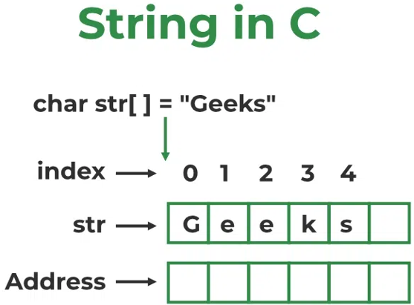
[1] String Declaration
Strings in C [Character Array]
A String in C programming is a sequence of characters terminated with a null character ‘\0’.
The C String is stored as an array of characters.
The difference between a character array and a C string is that the string in C is terminated with a unique character ‘\0’.
//method-1
char string_name[size];
Ex: Char Subject[50]
There is an extra terminating character which is the Null character (‘\0’) used to indicate the termination of a string that differs strings from normal character arrays.
//method-2
int length;
scanf(“%d”, &length);
char str[length];

Slide 44
[2] String Initialization
5. Assigning using User Input
main(){
int length;
scanf(“%d”, &length);
char name[length];
for(i = 0; i<length; i++){
scanf(“%c”, &name[ i ] );
}
}
1. Assigning a String Literal without Size
char str[] = "GeeksforGeeks";
2. Assigning a String Literal with a Predefined Size
char str[13] = "GeeksforGeeks";
3. Assigning Character by Character with Size
char str[14] = { 'G','e','e','k','s','f','o','r','G','e','e','k','s','\0’};
4. Assigning Character by Character without Size
char str[] = { 'G','e','e','k','s','f','o','r','G','e','e','k','s','\0’};
6. String Input using scanset
main(){
int length;
scanf(“%d”, &length);
char name[length];
scanf("%[^\n]s", str);
}

Slide 45
[3] String Access [ How to print a character array? ]
//method-3
char str[14] = { 'G','e','e','k','s','f','o','r','G','e','e','k','s','\0'};
for(int i=0; i<13; i++)
{
printf("%c", str[i]);
}
//method -1
int main(){
char name[] = "GeeksforGeeks";
for(i =0 ; i < strlen(name); i++)
{
printf(“%c”, name[i]);
}
}
//method-4
char str[ ] = { 'G','e','e','k','s','f','o','r','G','e','e','k','s','\0'};
for(int i=0; i< strlen(str); i++)
{
printf("%c", str[i]);
}
5. Assigning using User Input
main(){
int length;
scanf(“%d”, &length);
char name[length];
for(i = 0; i<length; i++){
scanf(“%c”, &name[ i ] );
}
for(i = 0; i<length; i++){
printf(“%c”, name[ i ] );
}
}
//method -2
int main(){
char name[13] = "GeeksforGeeks";
for(i =0 ; i < 13; i++)
{
printf(“%c”, name[i]);
}
}
6. String Input using scanset
main(){
int length;
scanf(“%d”, &length);
char name[length];
scanf("%[^\n]s", str);
printf("%s",str);
}

Slide 46
[4] String Update [ How to Modify a character array? ]
//method-3
char str[14] = { 'G','e','e','k','s','f','o','r','G','e','e','k','s','\0’};
str[1]=‘x’;
for(int i=0; i<13; i++)
{
printf("%c", str[i]);
}
int main(){
char name[] = "GeeksforGeeks";
name[0]='m';
for(int i =0 ; i < strlen(name); i++)
{
printf("%c", name[i]);
}
}
5. Assigning using User Input
main(){
int length;
scanf(“%d”, &length);
char name[length];
for(i = 0; i<length; i++){
scanf(“%c”, &name[ i ] );
}
name[0]=‘c’;
for(i = 0; i<length; i++){
printf(“%c”, name[ i ] );
}
}
6. String Input using scanset
main(){
int length;
scanf(“%d”, &length);
char name[length];
scanf("%[^\n]s", str);
str[0] = ‘p’;
printf("%s",str);
}
//method -2
int main(){
char name[13] = "GeeksforGeeks";
name[0]='m';
for(int i =0 ; i < strlen(name); i++)
{
printf("%c", name[i]);
}
}

Slide 47
[5] String Traversal [ How to print a character array? ]
Try using for(), while(), do-while() loop.
main(){
int length;
scanf(“%d”, &length);
char name[length];
for(i = 0; i<length; i++){
scanf(“%c”, &name[ i ] );
}
for(i = 0; i<length; i++){
printf(“%c”, name[ i ] );
}
}

Slide 48
Standard C Library – String.h Functions
The C language comes bundled with <string.h> which contains some useful string-handling functions. Some of them are as follows:
Function Name | Description
strlen(string_name) | Returns the length of string name.
strcpy(s1, s2) | Copies the contents of string s2 to string s1.
strcmp(str1, str2) | Compares the first string with the second string. If strings are the same it returns 0.
strcat(s1, s2) | Concat s1 string with s2 string and the result is stored in the first string.
strlwr() | Converts string to lowercase.
strupr() | Converts string to uppercase.
strstr(s1, s2) | Find the first occurrence of s2 in s1.

Slide 49
String programs using built-in functions()
C programming Bangla Tutorial 5.185 : String | finding length of String using strlen() function
C programming Bangla Tutorial 5.187 : String | copy string using strcpy()
C programming Bangla Tutorial 5.188 : String | concatenation using strcat()
C programming Bangla Tutorial 5.191 : String | String reverse using strrev()
C programming Bangla Tutorial 5.195 : String | strupr() and strlwr()
Check if two strings are same or not
C programming Bangla Tutorial 5.193 : String | string palindrome
C programming Bangla Tutorial 5.196 : String | Number of vowels, consonants, Number of capital-small letters and others.

Slide 50
String programs using built-in functions()
#include<stdio.h>
int main(){
///string length
char word[] = "abcdef";
printf("%d\n", strlen(word));
///copy string from s1 to s2
char s1[] = "hello world";
char s2[] = "computer engineering";
strcpy(s2,s1);
strcpy(s1, "I love coding");
printf("%s %s\n", s1, s2);
///strcat(): add to string
strcat(s1,s2);
printf("%s\n", s1);
//strlwr(), strupr()
char a[]="ARGENTINA";
char b[]="brazil";
printf("%s %s\n", strlwr(a), strupr(b));
printf("%s %s\n", strrev(a), strrev(b));
}
Output:
6
I love coding hello world
I love codinghello world
argentina BRAZIL
anitnegra LIZARB

Slide 51
Check equality of two string:
int main(){
char str1[100] ;
char str2[100] ;
scanf("%s", &str1);
scanf("%s", &str2);
if(strlen(str1) == strlen(str2)){
int check = 0;
for(int i=0; i<strlen(str1); i++){
if(str1[i] != str2[i]){
check=1;
break;
}
}
if(check == 0){
printf("\nequal");
}
else{
printf("\nNot equal");
}
}
else{
printf("\nNot equal");
}
}
Palindrome checking:
int main(){
char str1[100] ;
char str2[100] ;
scanf("%s", &str1);
scanf("%s", &str2);
if(strlen(str1) == strlen(str2)){
int check = 0;
for(int i=0; i<strlen(str1); i++){
if(str1[i] != str2[i]){
check=1;
break;
}
}
if(check == 0){
printf("\nequal");
}
else{
printf("\nNot equal");
}
}
else{
printf("\nNot equal");
}
}

Slide 52
Count small, capital letters, vowel and consonant from a string
int main(){
char s[100]; printf("Enter a line: ");
scanf("%[^\n]s", s);
printf("you have typed: %s\n\n\n", s);
int small=0,capital=0,vowel=0,consonent=0, others=0;
for(int i=0; i<strlen(s); i++){
if((s[i] >= 'A' && s[i]<='Z') || (s[i] >= 'a' && s[i]<='z')){
if((s[i] >= 'A' && s[i]<='Z’)){ capital++; }
if((s[i] >= 'a' && s[i]<='z’)){ small++; }
if(s[i]=='a' || s[i]=='e' || s[i]=='i' || s[i]=='o' || s[i]=='u’){ vowel++; }
if(s[i]=='A' || s[i]=='E' || s[i]=='I' || s[i]=='O' || s[i]=='U’){ vowel++; }
else{ consonent++; }
}
else{
others++;
}
}
printf("Capital Letter: %d\n", capital);
printf("Small Letter: %d\n", small);
printf("Vowel : %d\n", vowel);
printf("Consonent: %d\n", consonent);
printf("Others : %d\n", others);
}

Slide 53
2D character array
character Array declaration
character Array initialization
character Array access
character Array update
character Array traversal

Slide 54
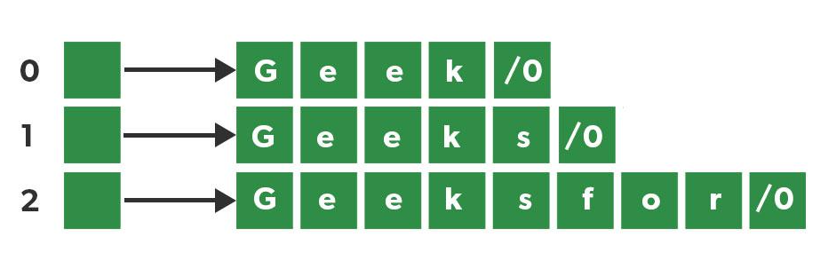
2D array

Slide 55
// C Program to print Array of strings
#include <stdio.h>
int main(){
char arr[3][12] = {"Geek", "Geeks", "Geekfor"};
printf("String array Elements are:\n");
for (int i = 0; i < 3; i++) {
printf("%s\n", arr[i]);
}
}

